Slide 1
DESIGN (ANTI-)PATTERNS
Null Object
Gabriela Maráková

Slide 2
WHAT ARE DESIGN PATTERNS
A software design pattern is a general, reusable solution to a commonly occurring problem. It is not a finished design that can be transformed directly into source or machine code. It is a description or template for how to solve a problem that can be used in many different situations. Design patterns are formalized best practices that the programmer can use to solve common problems when designing an application or system.
Types
Creational (singleton, builder, lazy init, abstract factory, object pool etc.)
Structural (adapter, bridge, decorator, facade, composite, proxy etc.)
Behavioral (iterator, strategy, template method, visitor, command etc.)
Concurrency (thread pool, double checked locking, monitor object, reactor etc.)

Slide 3
Null Object
GoF Definition
“The intent of a Null Object is to encapsulate the absence of an object by providing a substitutable alternative that offers suitable default do nothing behavior.” (Design Patterns: Elements of Reusable Object-Oriented Software)
What is the Null Object pattern good for?
instead of putting if check for a null value, Null Object reflects a do nothing behavior
to provide default behavior in case data is not available
to abstract the handling of null away from the client
particular case of the strategy pattern in which we choose the strategy of doing nothing

Slide 4
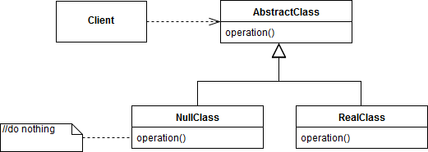
Participants
Class diagram
Client – the user of an interchangeable algorithm.
AbstractClass – defines operations (abstract class or interface in java).
RealClass – provides real implementation.
NullClass – provides “do nothing” implementation. Can replace the RealClass in our program.

Slide 5
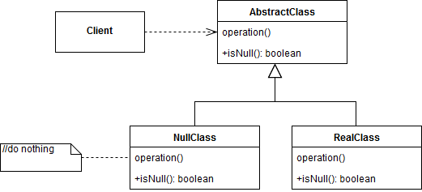
Participants
Class diagram
Client – the user of an interchangeable algorithm.
AbstractClass – defines operations (abstract class or interface in java).
RealClass – provides real implementation.
NullClass – provides “do nothing” implementation. Can replace the RealClass in our program.

Slide 6
NullObject Demo – Invalid input handler

Slide 7
Null Object
Benefits
avoids a large number of null checks and if/else blocks (before every usage of object in client code)
helps us to implement a default behavior when you want to deal with an object that is not present at all
prevents NullPointerException in Java

Slide 8
Null Object
Pitfalls
It can make bugs appear as a normal program execution - null value is not explicitly handled by any handler (however, it can be valid use case in some cases)
Can be difficult to implement if various clients do not agree on how the null object should do nothing
We should not implement this pattern just to avoid null checks

Slide 9
Null Object
Combinations
Null Object + Singleton
Null Object usually does not have any state
Rather than use multiple identical instances, the system can just use a single instance repeatedly.
Null Object + Factory
Factory returns Real Object or Null Object
Null Object + Visitor
Allow a Visitor to safely visit a hierarchy and handle the null situation
...

Slide 10
Null Object
Real world examples
Handling invalid input
Controller (Real Object) is a View's Strategy (View = AbstractClass) for handling input, and NoController (Null Object) is the strategy that ignores all input
Handling of customer which was not found in database
adapter classes in java.awt.event package - empty bodies like mouseDragged(MouseEvent e){ }, mouseMoved(MouseEvent e){ }

Slide 11
Null Object
References
Design Patterns and Best Practices in Java - Adrian Ianculescu; Lucian-Paul Torje; Kamalmeet Singh https://learning.oreilly.com/library/view/design-patterns-and/9781786463593/54e890ba-e824-4ad9-b04c-cf70437561d8.xhtml
Java Design Patterns: A Hands-On Experience with Real-World Examples - By Vaskaran Sarcar https://learning.oreilly.com/library/view/java-design-patterns/9781484240786/html/395506_2_En_25_Chapter.xhtml
https://www.tutorialspoint.com/design_pattern/null_object_pattern.htm
https://www.geeksforgeeks.org/null-object-design-pattern/
https://sourcemaking.com/design_patterns/null_object
https://dzone.com/articles/null-object-pattern-in-java

Slide 12
Questions and discussion

